Slide 1

M202161029
ALEC MABHIZA CHIRAWU - 亚历克上
HOLIDAY REPORT
Palisade homomophic Encryption

Slide 2
During the vacation i studied papers and watched lot of seminars related to HE, SHE, FHE.
Seminars i have watched includes :
1) Cryptography Seminar by Professor :Christof Paar
https://www.youtube.com/watch?v=2aHkqB2-46k&list=PL2jrku-ebl3H50FiEPr4erSJiJHURM9BX
2) Palisade - HE
https://www.youtube.com/watch?v=FLGeMd3eiQY
3) Read recent papers on Palisade.
My focus during the holiday was to undestand Lattigo library and palisade library and decide which one to use during my researches.

Slide 3
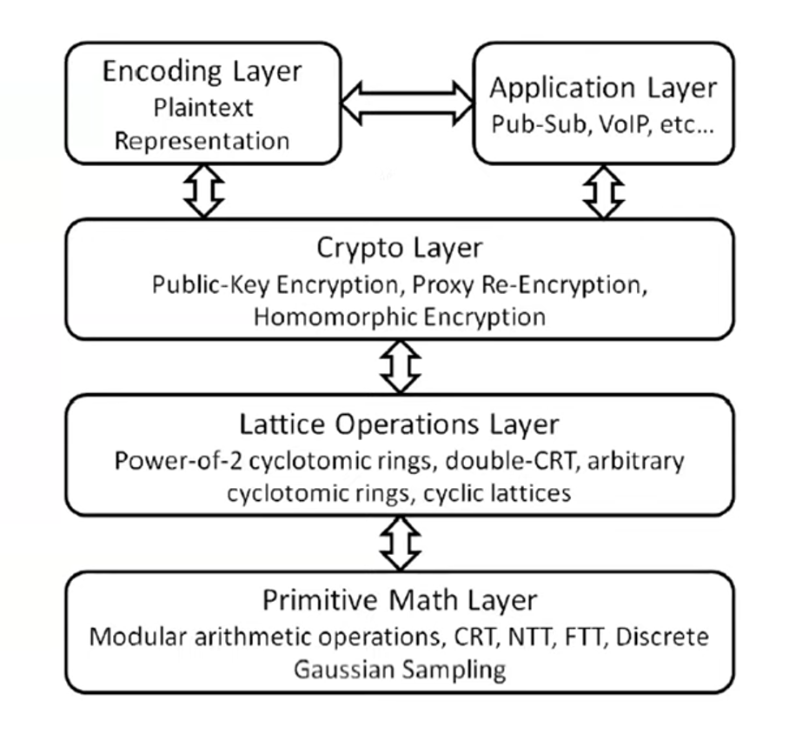
Palisade
Palisade has attracted more attention in the field of cryptography. It have lot of capabilities including that: it can construct homomorphic encryption and its capable of process the encrypted data without even decrypt it increasing data security in this way.
Besides being capable of lot of things , palisade is easier to understand and to work with and its results have been productive.
Palisade modular architecture makes palisade more effective and powerful.
Palisade supports the following FHE schemes :
1) Brakerski/ Fan- vercauteren (BFV) scheme for interger arithmetic.
2) Brakerski-Gentry-Vaikuntanathan (BGV) sheme for interger arithmetic
3) CKKS scheme for real-numbers arithmetic
4) Ducas-Micciancio (FHEW) and Chillotti-Gama-Izabachene (TFHE) shemes for Boolean circuit evaluation
5) Stehle-Steinfeld scheme for limited integer arithmetic

Slide 4
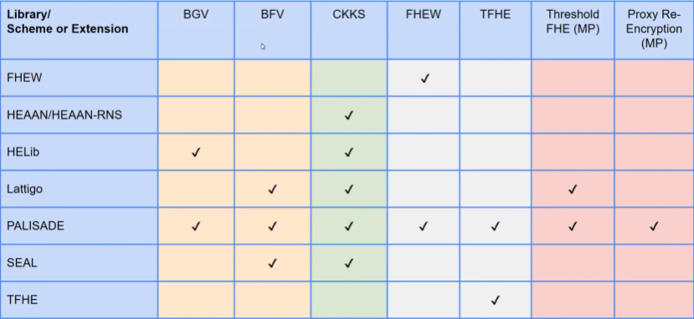
SCHEMES SUPPORTED BY PALISADE

Slide 5
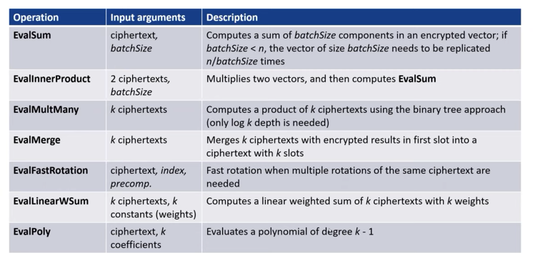
HIGHER-LEVEL OPERATIONS
Palisade CKKS implementation supports multiparty FHE using the threshold FHE approach.

Slide 6
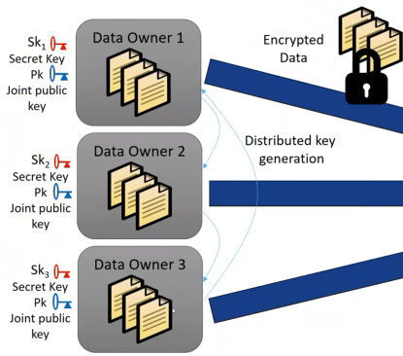
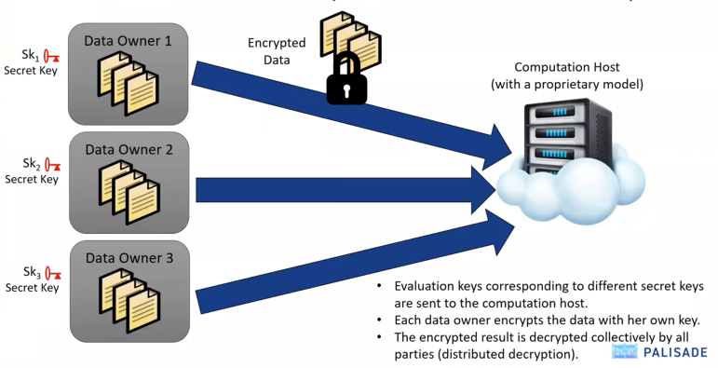
Threshold HE
Palisade allows data owners to distribute their data using public key with out need to decrypt it.

Slide 7
Field Programmable Gates Arrays(FPGA)
Boolean logic
a)Circuits of Gates
b)Logic Equations
c)Truth tables
- Circuit diagrams / schematics(gates and wires) palisade lets you connect gates together via C++.
- Palisade encrypted circuit emulator lets you script your own circuits and reads in some net list formats which is good for circuits with more than 1000 gates.
- fast serial and de-serialisation
XILINX
INTEL
MICROCHIP
LATTICE

Slide 8
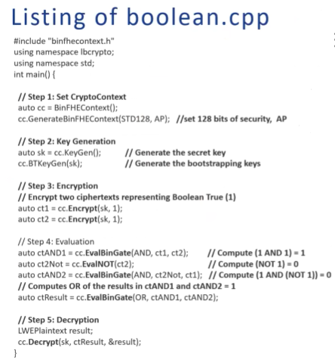
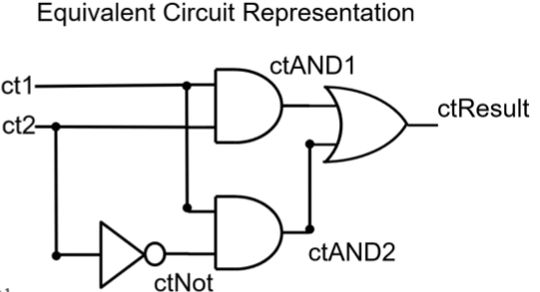
FPGA backbone
Each wire is a ciphertext
Each gate is a function call
Inputs are encrypted
Outputs are decrypted
electronics and software

Slide 9
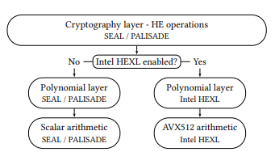
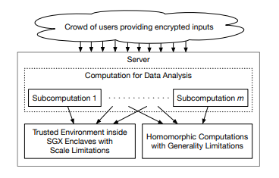
Some of the Researches which have been done using palisade library
1) Intel HEXL: Accelerating Homomorphic Encryption with Intel AVX512-IFMA52(2021)
The research deeply focus intel processors using BGV, BFV and CKKS shemes for number theoretic transform(NTT).
2) GPS: Integration of Graphene, PALISADE, and SGX for Large-scale Aggregations of Distributed Data(2021)
The research makes use of the advantage that palisade is capable of working with decrypted data , there giving allowance to high data computation of millions of data.
The research adds more security on mobile GPS and also increase its effiecients.

Slide 10
Conclusion
As for the conclusion i think its is better to use palisade library than lattigo library due to these reasons:
1) Palisade now have more attention than lattigo.
2) Besides the fact that go language is more fast in computing than python , palisade library proved to be more faster on processing data due to the fact that it does not decrypt it when doing computation resulting in high speed and high accuracy.
3) palisade does have encapsulating lot of module calls even though it has one problem which is hardware acceleration is not effecient enough.
4) generally its easier to study and to master than lattigo.

